Slide 1
Contracting Management (7060MAA) Group coursework -1
Ninad Killedar
Student ID Number : 12775008

Slide 2



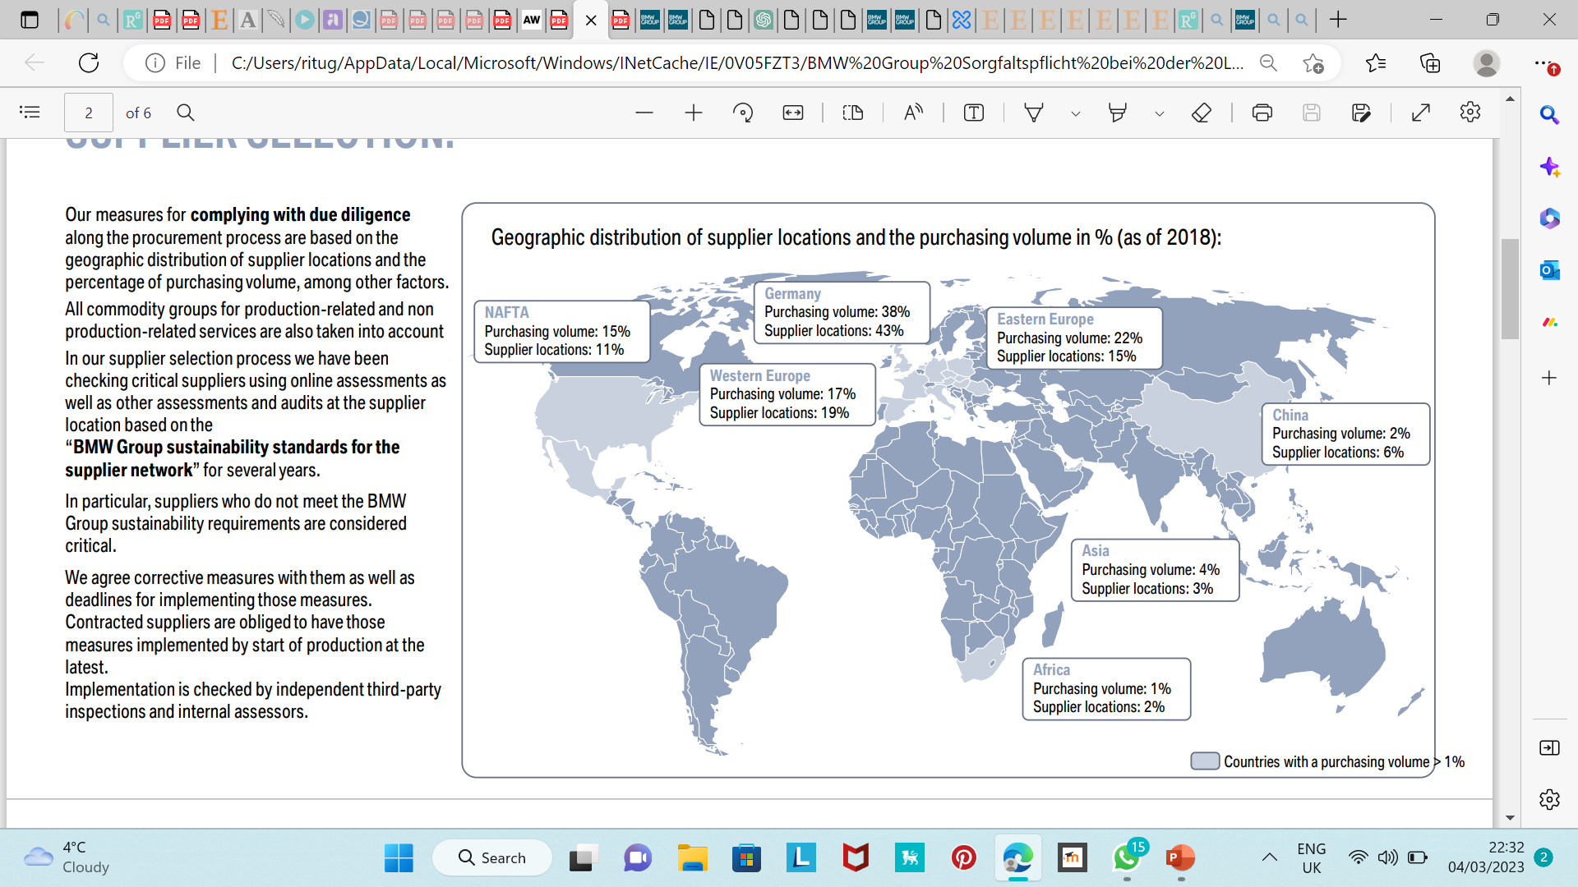
INTRODUCTION
BMW is a German multinational corporation that manufactures luxury vehicles and motorcycles and is known for its commitment to sustainability. (BMW Group, 2019)
For example, Cobalt is a raw material that is procured for the production of high and low voltage next generation batteries to generate green electricity and was installed in the BMW iX electric car model. (BMW Group, 2019)
BMW works closely with its direct and indirect suppliers to ensure that they meet the company's sustainability standards. These suppliers provide components and systems for BMW's production facilities around the world. (BMW Group, 2019)
Procuring Cobalt
Procuring Cobalt
Morocco mines
Australia mines
Earlier, BMW used to purchase cobalt-containing battery cells but, in recent years in order to increase supply chain transparency and traceability it directly procures cobalt mainly from mines in Australia and Morocco but also from 10 other refineries/smelters. (BMW Group, 2019)
Potential problems in sourcing Cobalt Source : Cobalt. (bmwgroup.com)
First problem, in sourcing cobalt is to ensure cobalt extraction and processing takes place in compliance with sustainability standards and to avoid problems with working conditions, e.g., child labour, forced labour, bribery etc.
Another problem is supplier selection process for quality assurance, direct and indirect costs, reliability, delivery or lead time and price negotiation of Cobalt. Hence, selection of such a potential supplier who operates in socially and environmentally responsible manner is critically important to an organization.
The growth of e-mobility makes value creation in the supplier network more important than ever, both in terms of CO2 emissions and the sourcing of critical raw materials, such as those required for battery cell mass production. (Automotive World, 2020)
Notes:
BMW is a German multinational corporation that manufactures luxury vehicles and is known for its commitment to sustainability. The figure shows major key markets of the organization from a purchasing and supplier point of view. The growth of e-mobility makes value creation in the supplier network more for sourcing of critical raw materials which are needed as a component to make rechargeable batteries for electric vehicles. One such critical raw material is COBALT. There are two potential problems in sourcing cobalt first is ensure cobalt extraction and processing takes place in compliance with sustainability standards and to avoid problems with working conditions, e.g., child labour, forced labour, bribery etc. and another is the selection of such potential suppliers who operates in social, ethical, and environmentally responsible.

Slide 3
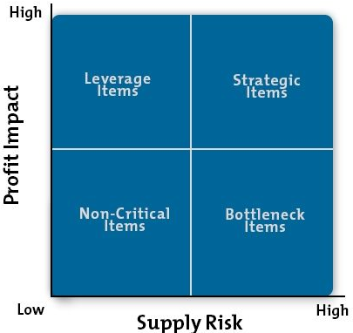
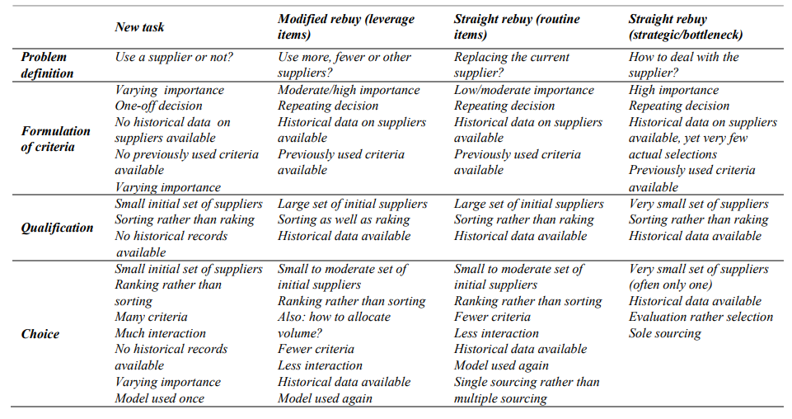
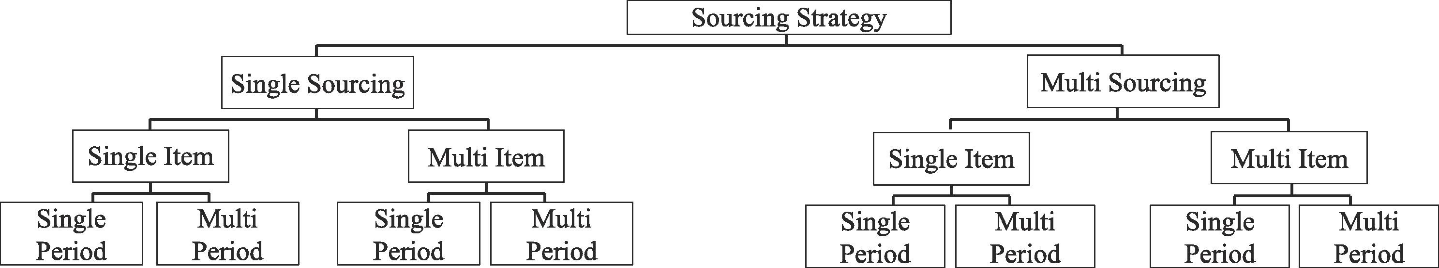
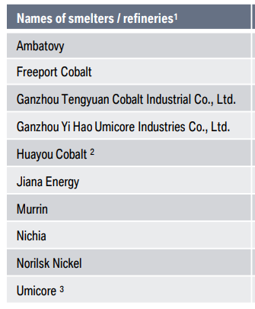
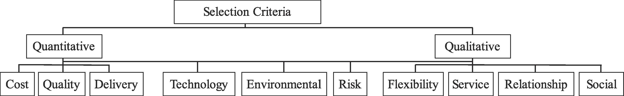
SUPPLIER SELECTION PROCESS FOR COBALT
SUPPLIER SELECTION PROCESS FOR COBALT
Identification of potential cobalt suppliers
Assessing criteria for Cobalt suppliers (Gaikwad & Sunnapwar, 2019)
Information Requests to cobalt suppliers (Beil, 2011)
Contract negotiation (Beil, 2011)
Selection and evaluation methods for Cobalt suppliers. (Taherdoost & Brard, 2019)
Price Negotiation- Fixed Pricing
Reference checks
Sustainability pre-qualification Questionnaire (Gupta et al., 2019)
On-site audits
Financial status check
Surge capacity availability check
Environmental certifications - ISO 14000 (Gupta et al., 2019)
Request for Proposal (RFP)
Analytic Hierarchy Process (AHP) (Rathore & Agarwal, 2016)
Preference Ranking Organization Method for Enrichment, Evaluations (PROMOTHEE) (Rathore & Agarwal, 2016)
Total Cost of Ownership (TCO) (Rathore & Agarwal, 2016)
Delivery Schedules
Payment Terms- Letter of Credit
Confidentiality and Termination Clauses
Quality Standards
COBALT
The main objective of a good supplier selection is to find the appropriate supplier who can provide the buyer with the right quality products or services at the right price, in the right quantities at the right time. (Taherdoost & Brard, 2019)
Source: Kraljic purchasing portfolio matrix (Padhi et al., 2012)
One of the most crucial components in SCM is supplier selection; is a multiple criteria decision making (MCDM) problem which involves both qualitative and quantitative criteria. (Mukherjee, 2017)
BMW Audits
DNV GL auditor - (Huayou Cobalt , 2017)
Source: (Saputro et al., 2022)
External auditor – PwC (Umicore, 2020)
Source: The supplier selection framework (de Boer et al., 2001)
Source: (BMW Group, 2019)
Notes:
Kraljic Purchasing portfolio matrix proposed in 1972 which has two dimensions supply risk and profit impact. And Cobalt can be categorized in the Kraljic Matrix as a strategic item due to : high supply risk determined by the level of complexity and uncertainty in the supply market and high profit impact determined by the level of expenditure on the product. This is because cobalt is a critical raw material used in the production of many high-tech products, such as rechargeable batteries in this case. The supply of cobalt is concentrated in a very few countries, mainly the Democratic Republic of Congo (DRC), Africa which is known for its political instability, poor working conditions, and human rights abuses. Thus, supply chain for cobalt is complex and presents a high level of supply risk for organizations like BMW. At the same time, the profit impact of cobalt can be significant for BMW that use it in their batteries for electric cars. The price of cobalt is volatile and subject to fluctuations based on supply and demand. This can have a significant impact on the cost of production for company like BMW that rely on cobalt.
Now we implement the supplier selection framework of De Boer, 1998
1) Problem definition:
Cobalt is deemed necessary, then the question becomes how to obtain it. Is it necessary to use multiple suppliers to ensure adequate supply, or is one supplier sufficient?
SO AS PER THE HIERARCHY TABLE ON THE LEFT WE ARE CHOOSING SOURCING STRATEGY AS – MULTISOURCING and a single item that is Cobalt for Multi-period (demand planning on monthly basis as demand for high voltage batteries may increase). Also, multi sourcing in order to maintain adequate supply and manage risk.
Varying importance: Cobalt may be of moderate to high importance, as it will be used in every high or low voltage battery of electric car
2) Formulation of criteria:
Let’s say If there is no historical data on cobalt suppliers available, then criteria for supplier selection would need to be developed from scratch.
3) Qualification:
There is a small initial set of 10 cobalt suppliers available, then the focus may be on evaluating and qualifying those suppliers.
THIS TABLE ON THE BOTTOM LEFT SHOWS 10 cobalt suppliers that need to be evaluated and selected.
4) Choice:
As there is a small initial set of cobalt suppliers available, then the focus may be on ranking the best to worst option from that set of 10 suppliers.
THUS, WE SHOULD PREFER
Ranking rather than sorting as:
As there are multiple potential cobalt suppliers, then a ranking process may be more appropriate than a sorting process.
Lastly, Deciding between Model used again or Model used once:
So cobalt procurement isn’t a one-time occurrence especially if the company is using it for making batteries that would be fitted inside an EV. Hence cobalt procurement is repeated over time, then the selection model may be used again in subsequent procurement decisions.
Now Coming to the flowchart first step of supplier selection process would be the Identification of potential cobalt suppliers by issuing sustainability questionnaire and identifying if they have Environmental certifications standard of ISO 14000. Then they will be assessed based on reference checks by contacting previous customers and asking about the supplier's delivery performance, then supplier's financial status would be checked if they have any significant debt or not. Third thing that would be assessed is Surge capacity Availability that is if supplier is capable to fulfil increased delivery quantities within short lead times or not. And at last on-site audits will be conducted at supplier’s facility to ensure the operation is going on in the manner as the buyer expects it to be.
After this Request for Proposal would be issued in this particular case . RFP’s are usually issued when a company has a specific product requirement and is seeking proposals from different potential suppliers to select the best option to meet that requirement.
Then comes selection of a supplier for cobalt procurement which depends on several factors, such as the quality of cobalt, cost, delivery time, supplier reputation, and reliability.
First we will use Analytic Hierarchy Process (AHP) as it is typically used in the early stages of the supplier selection process when the buyer is trying to identify the most important criteria for selecting a supplier. It can be used to develop a decision hierarchy to compare different suppliers against each criterion.
Then (PROMOTHEE) which is an outranking method that can be used in the middle stage of the supplier selection process to rank the potential cobalt suppliers based on their performance in various criteria and identify their conflicting areas.
At last Total Cost of Ownership – TCO which can be helpful in considering the both direct and indirect costs associated with purchasing cobalt from a particular supplier over the entire lifecycle of cobalt. TCO can be used in last stage of supplier selection process to identify potential suppliers from the cost perspective that offer lowest total cost.
TABLE ON THE LEFT SHOWS THE SELECTION CRITERIA WHICH IS EVENTUALLY DIVIDED IN TO QUALITATIVE AND QUANTITATIVE. TCO IS AN QUANTITAVE APPROACH WHILE AHP AND PROMOTHEE TAKE IN ACCOUNT BOTH QUALITATIVE AND QUANTITATIVE ASPECTS.
With this we come to last step that is Contract Negotiation
There are several types of price negotiation that can be used in supplier selection processes, such as Competitive bidding where the organization requests bids from multiple suppliers and selects the one with the lowest price. Or Market-based or Value-based pricing. But the most efficient is Fixed pricing as it ensure price stability as market price of cobalt is highly volatile as I mentioned earlier.
The organization should agree on the delivery schedule for the cobalt, including the frequency and location of deliveries, also the quantity to be delivered in each shipment.
The payment terms for the cobalt, including the payment schedule, method of payment, and any penalties for late payment or non-payment should be fixated. The best method here would be issuing letter of credit from a bank that guarantees payment to the supplier upon delivery of the cobalt. This method can be beneficial if the organization is working with a new or high-risk supplier and wants to ensure payment security for both parties.
The organization and the supplier may need to negotiate confidentiality agreements and also establish the conditions under which the contract can be terminated by either party.

Slide 4
Supplier Risk Analysis and Mitigation Strategy
P.E.S.T.L.E Factors | Risk Analysis (Mancini et al., 2021) | Risk Mitigation
Political Risks | Changes in government policies related to cobalt production, trade, or taxation. Political instability in key cobalt-producing regions, which can disrupt supply chains. For example: Democratic Republic of Congo (DRC), Africa . | Maintain a diverse supply chain that includes suppliers from different regions to minimize the impact of political instability in any one region. Establish long-term relationships with suppliers and engage in regular communication to stay informed about changes in government policies and regulations. Develop contingency plans for disruptions to the cobalt supply chain due to political instability, such as stockpiling cobalt or diversifying sourcing strategies.
Economical Risks | Fluctuations in the global price of cobalt, which can impact supplier profitability and stability. Currency fluctuations that can impact the cost of cobalt and the ability of suppliers to fulfil orders. Economic instability or recessions that can impact demand for cobalt and supplier stability. | Establish contracts with cobalt suppliers that include fixed price guarantees and flexible but secure payment terms such as letter of credit to minimize the impact of price fluctuations and currency fluctuations. Conduct regular market research to stay informed about changes in global cobalt supply and demand trends.
Sociocultural Risks | Social and political pressure to adopt ethical and sustainable sourcing practices. Public perception of suppliers and their practices, which can impact their reputation and profitability. Labour practices and human rights issues associated with cobalt mining and production. | Adopt ethical and sustainable sourcing practices and communicate these practices to stakeholders to build trust and maintain a positive reputation. Establish codes of conduct and other standards for cobalt suppliers related to labour practices and human rights. Conduct regular audits and inspections of cobalt suppliers to ensure compliance with these standards.
Technological Risks | Rapid advancements in cobalt extraction and processing technologies, which can make some suppliers obsolete. The need to invest in new technologies to remain competitive in the cobalt supply chain. | Stay informed about technological advancements in the cobalt industry and Invest in new technologies to remain competitive in the cobalt supply chain and reduce the risk of technological obsolescence.
Legal Risks | Non-compliance with labour, environmental, or other regulations related to cobalt mining and production. Legal disputes with suppliers related to contracts, intellectual property, or other issues. | Establish clear contracts with cobalt suppliers that outline legal responsibilities and obligations. Conduct thorough due diligence on potential suppliers to ensure compliance with legal and regulatory requirements. Work with legal experts to stay informed about changes in laws and regulations related to cobalt production and transportation.
Environmental Risks | Environmental damage caused by cobalt mining and production, which can impact the reputation of suppliers and their ability to operate. Regulatory or legal penalties associated with environmental non-compliance. | Adopt sustainable and environmentally friendly sourcing practices and communicate these practices to stakeholders. Conduct regular environmental assessments of cobalt suppliers to ensure compliance with environmental regulations.
RISK MITIGATION STRATEGY-
Performing Corporate Due Diligence in the supplier selection processes
Criteria of compliance | Minimum Requirements for suppliers
Responsible Business Practices | (BMW Group Supplier Code of conduct , 2022)
Environmental Responsibility | (BHP, 2022)
Handling hazardous materials and waste | (BMW Group Supplier Code of conduct , 2022)
Community Interaction | (BHP, 2022)
Prohibition of child labour | (BHP, 2022)
Prohibition of forced labour and slavery | (BHP, 2022)
Protection against discrimination | (BHP, 2022)
Right to health and safety in the workplace | (BHP, 2022)
Use of Critical Raw Materials | (BMW Group Supplier Code of conduct , 2022)
Human Trafficking | (BHP, 2022)
Corruptions, Bribery and Extortion | (BHP, 2022)
Notes:
RISK ASSESSMENT
PESTLE analysis is a tool used to identify and analyse Political, Economic, Sociocultural, Technological, Legal, and Environmental risks that may affect an organization's operations, including the supplier selection process. The table below outlines some potential risks for each factor that could be identified in each of these areas when evaluating cobalt suppliers: By considering each of these factors, organizations can make more informed decisions about which suppliers to work with and how to mitigate potential risks.
RISK MITIGATION
Risk mitigation can involve implementing preventive measures for each aspect of the PESTEL analysis, along with performing corporate due diligence during supplier selection, and establishing compliance criteria for suppliers to follow which is showed in another table.

Slide 5

Audio Recording

Slide 6
REFERENCES
Automotive World (2020) BMW Group purchasing steps up sustainability activities and paves the way for future E-mobility growth, Automotive World. Available at: https://www.automotiveworld.com/news-releases/bmw-group-purchasing-steps-up-sustainability-activities-and-paves-the-way-for-future-e-mobility-growth/ (Accessed: March 1, 2023).
Beil, D.R. (2011) “Supplier selection,” Wiley Encyclopedia of Operations Research and Management Science, pp. 1–13. Available at: https://doi.org/10.1002/9780470400531.eorms0852.
BMW Group Supplier Code of conduct (BMW Group supplier sustainability policy) (2022) BMW Group . Available at: https://www.bmwgroup.com/content/dam/grpw/websites/bmwgroup_com/responsibility/downloads/en/2022/BMW-Group-Supplier-Code-of-Conduct-V.3.0_englisch_20221206.pdf (Accessed: March 2, 2023).
Cobalt. (no date) BMW Group. Available at: https://www.bmwgroup.com/en/sustainability/our-focus/environmental-and-social-standards/supply-chain/rohstoffe-teaser/kobalt.html (Accessed: March 2, 2023).
de Boer, L., Labro, E. and Morlacchi, P. (2001) “A review of methods supporting supplier selection,” European Journal of Purchasing & Supply Management, 7(2), pp. 75–89. Available at: https://doi.org/10.1016/s0969-7012(00)00028-9.
DNV GL - Audit report on Huayou Cobalt (2017). Available at: https://www.lgensol.com/asset/battery/file/Audit_Report_on_Huayou_Cobalt.pdf (Accessed: March 2, 2023).
Gaikwad, L. and Sunnapwar, V. (2019) “Supplier evaluation and selection in automobile industry,” Industrial Engineering, p. 102. Available at: https://doi.org/10.5772/intechopen.84383.
Gupta, S., Soni, U. and Kumar, G. (2019) “Green supplier selection using multi-criterion decision making under Fuzzy Environment: A Case Study in automotive industry,” Computers & Industrial Engineering, 136, pp. 663–680. Available at: https://doi.org/10.1016/j.cie.2019.07.038.
Mancini, L. et al. (2021) “Assessing impacts of responsible sourcing initiatives for cobalt: Insights from a case study,” Resources Policy, 71, p. 102015. Available at: https://doi.org/10.1016/j.resourpol.2021.102015.
Minimum requirements for suppliers (2022) BHP. Available at: https://www.bhp.com/-/media/documents/suppliers/200304_minimum-requirements-for-suppliers.pdf?la=en (Accessed: March 2, 2023).
Mukherjee, K. (2017) Supplier selection an MCDA-based approach. New Delhi: Springer India.
Padhi, S.S., Wagner, S.M. and Aggarwal, V. (2012) “Positioning of commodities using the Kraljic portfolio matrix,” Journal of Purchasing and Supply Management, 18(1), pp. 1–8. Available at: https://doi.org/10.1016/j.pursup.2011.10.001.
Rathore, C.S. and Agarwal, S. (2016) “SUPPLIER SELECTION PROCESS IN SUPPLY CHAIN MANAGEMENT,” INTERNATIONAL JOURNAL OF ENGINEERING SCIENCES & RESEARCH TECHNOLOGY, 5(9), pp. 24–29. Available at: https://doi.org/10.5281/zenodo.61446.
Saputro, T.E., Figueira, G. and Almada-Lobo, B. (2022) “A comprehensive framework and literature review of supplier selection under different purchasing strategies,” Computers & Industrial Engineering, 167, p. 108010. Available at: https://doi.org/10.1016/j.cie.2022.108010.
Sustainability in procurement and the supplier network. (2019). Available at: https://www.bmwgroup.com/content/dam/grpw/websites/bmwgroup_com/responsibility/downloads/en/2019/BMW%20Group%20Sorgfaltspflicht%20bei%20der%20Lieferantenauswahl_EN.pdf (Accessed: March 1, 2023).
Taherdoost, H. and Brard, A. (2019) “Analyzing the process of supplier selection criteria and methods,” Procedia Manufacturing, 32, pp. 1024–1034. Available at: https://doi.org/10.1016/j.promfg.2019.02.317.
Umicore's Sustainable Cobalt Procurement externally validated for the 6th year in a row (2020) Umicore. Available at: https://rbm.umicore.com/en/stories/sustainable-cobalt-procurement-validated-6th-year-row/#:~:text=Umicore%20obtained%2C%20for%20the%20sixth%20year%20in%20a,under%20which%20raw%20materials%20are%20extracted%20and%20processed. (Accessed: March 2, 2023).

